Slide 1
PYSINDY PREBIOTIC CHEMISTRY SPRING 2022
AYAN DEEP HAZRA

Slide 2
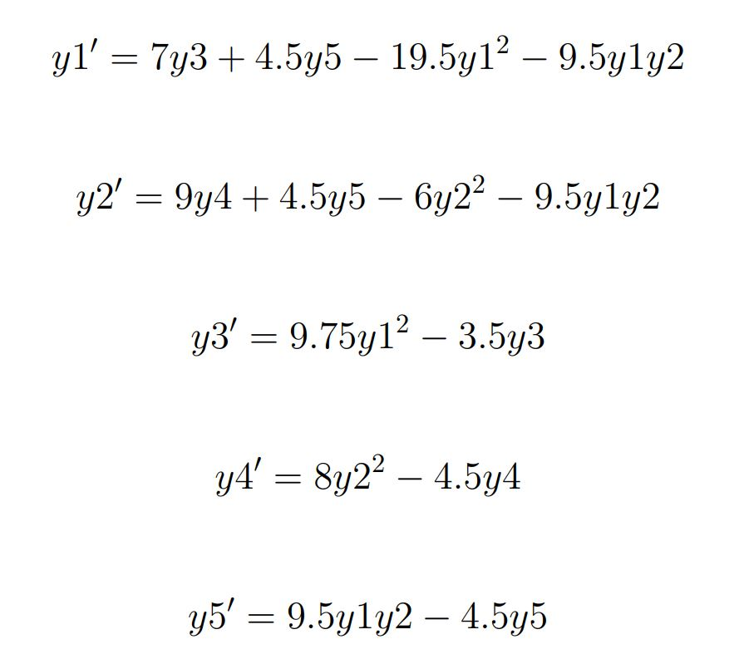
BACKGROUND
Using Pysindy, to generate ODEs of glycine-alanine reactions.
Using an original model (below) as the base for model recovery.

Slide 3
FROM LAST TIME
Was incorrectly adding noise to the data. Was adding noise to different sets of data, and comparing the two. Resolved!
Taking a dataset, adding noise to it, fitting two different models based on no-noise dataset and noise dataset.
The forward simulation analysis between the two models, is done on the basis of how much noise was added to the no-noise data (based on the standard deviation using a normal distribution.)
Formula applied to every datapoint: Noisy data = data + N(0, sigma) * data

Slide 4
COMPARISONS TO REAL LAB
Really small standard deviations of noise were added to the data, ranging from 0.01 to 0.05, and mass balance checking was done based on this with a bound of +- 20% from the true value.
Realistic Lab Sampling Rate -> Once every 30 minutes or 48 times a day.
Over 2 days that would be 96 samples. Rounded to 100 for simplicity.

Slide 5
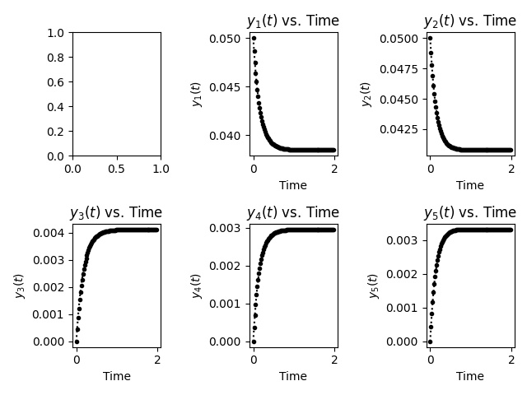
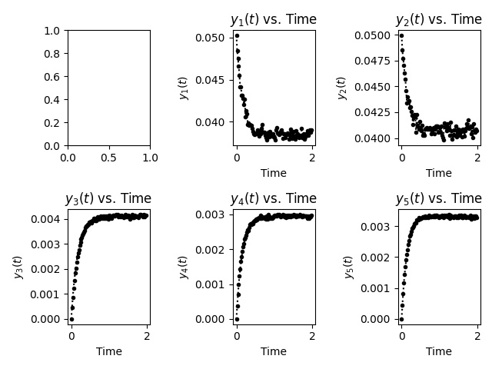
50-50 @ 0.01 s.d.
100 timepoints
Original Model
No-Noise Simulation of Original Model
Noisy data added Simulation

Slide 6
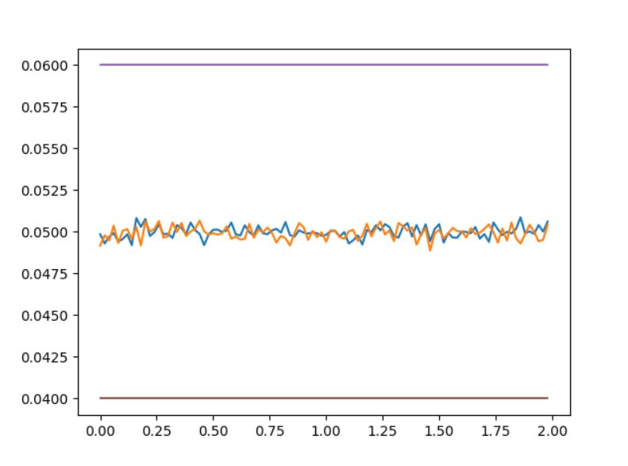
MASS BALANCE ANALYSIS OF ABOVE RUN
Original Model

Slide 7
MASS BALANCE CALCULATIONS

Slide 8
MASS BALANCE
Calculated the mass balance for every time step.
Used the actual molecular weights of the species.
Compared each value to the expected mass balance of the initial conditions.

Slide 9

ERROR
Error was calculated at each point, using the difference / expected formula.
The error at each timestep was averaged out, and a score was reported for both the No-Noise Model and the Noise Model.

Slide 10
ERROR ANALYSIS (FOR 100 TIMEPOINTS)

Slide 11
ERROR ANALYSIS (FOR 90-10 IC)

